Slide 1

UKIYO ROBSTOP
By,
Chandhana Menon
1NH17CS712

Slide 2
What is Ukiyo Robstop ?
An online shopping portal exclusively for robots. One can pick an appropriate robot according to their requirements, cost and quality. Customer will require to login to the system by providing their full name, email address, phone number when creating an account.
Frontend- Python3
Backend- SQLite3

Slide 3
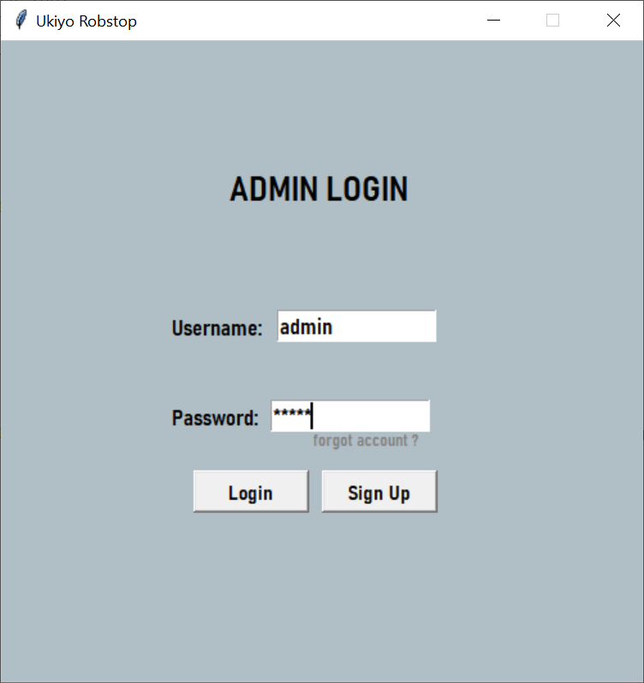
Admin Login

Slide 4
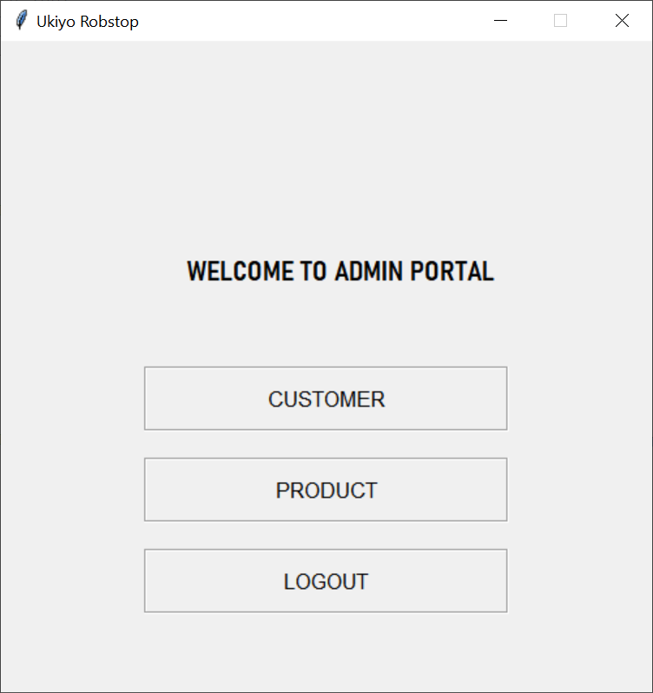
Admin Portal

Slide 5
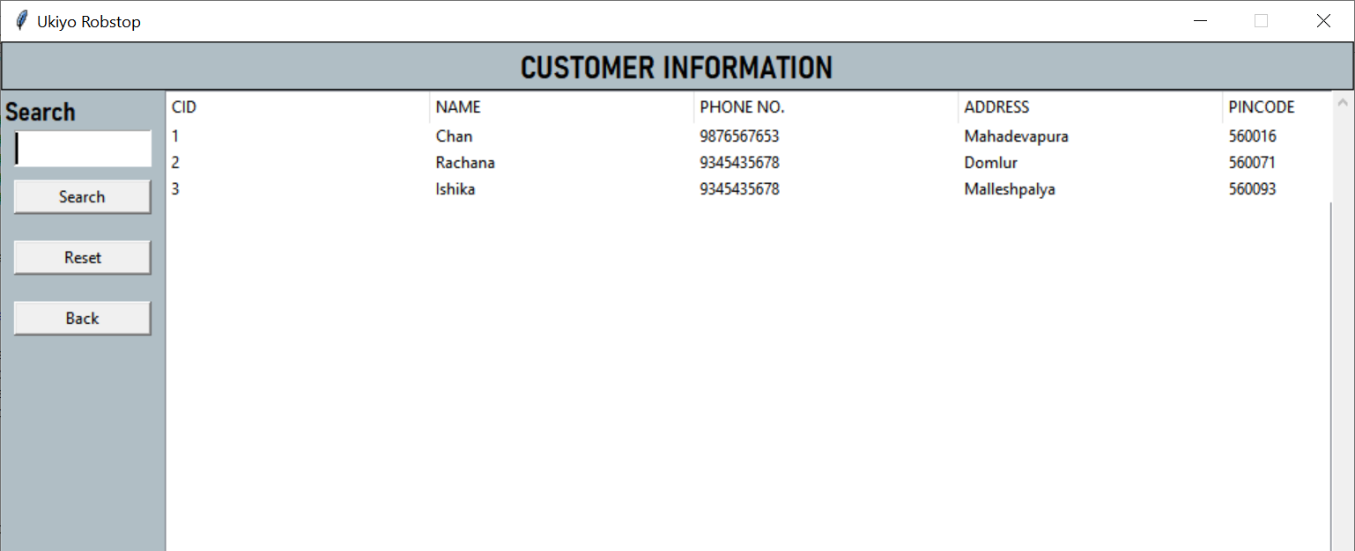
Customer Information

Slide 6
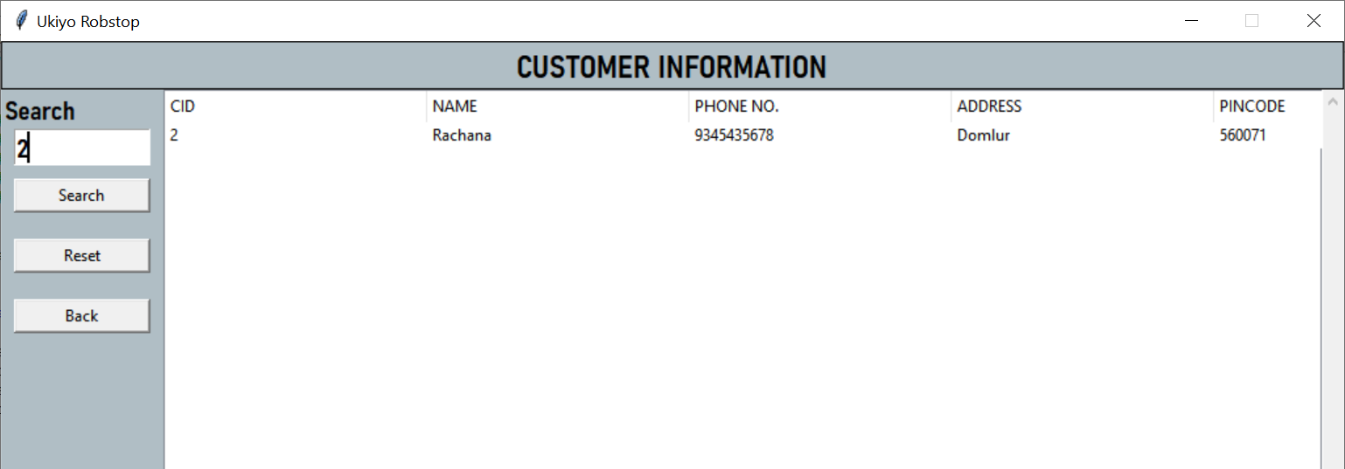
Search Customer By Customer ID

Slide 7
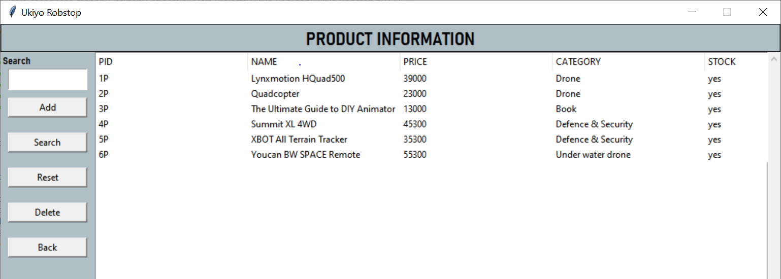
Product Information

Slide 8
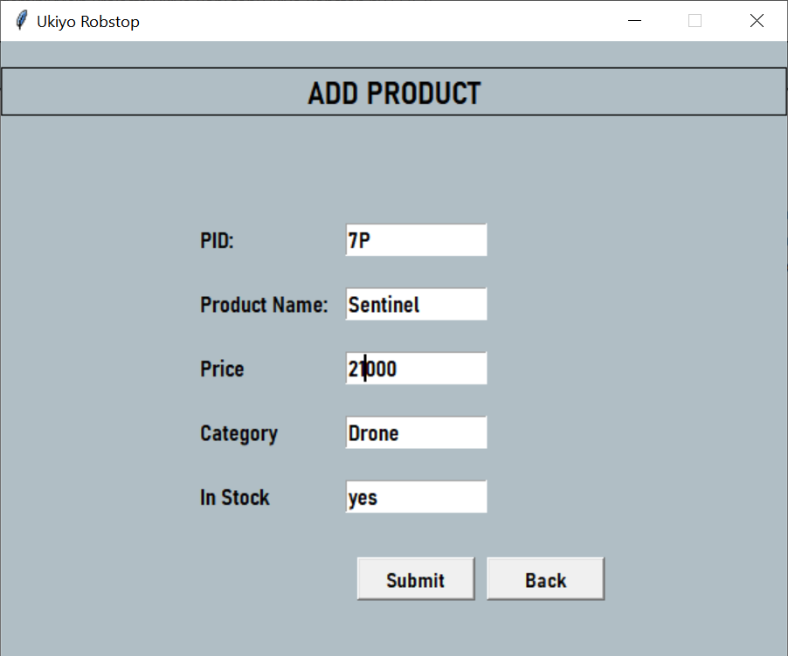
Add New Product

Slide 9
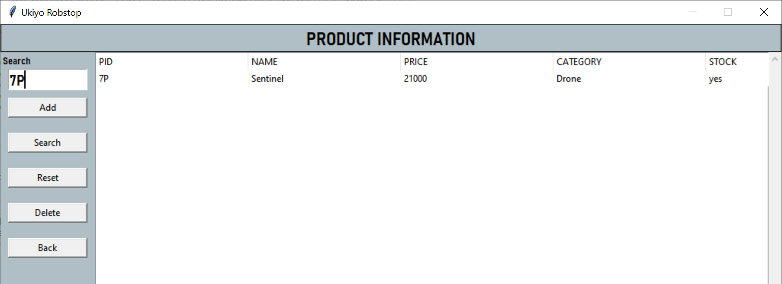
Search Product by Product ID

Slide 10

Reset The Product List

Slide 11
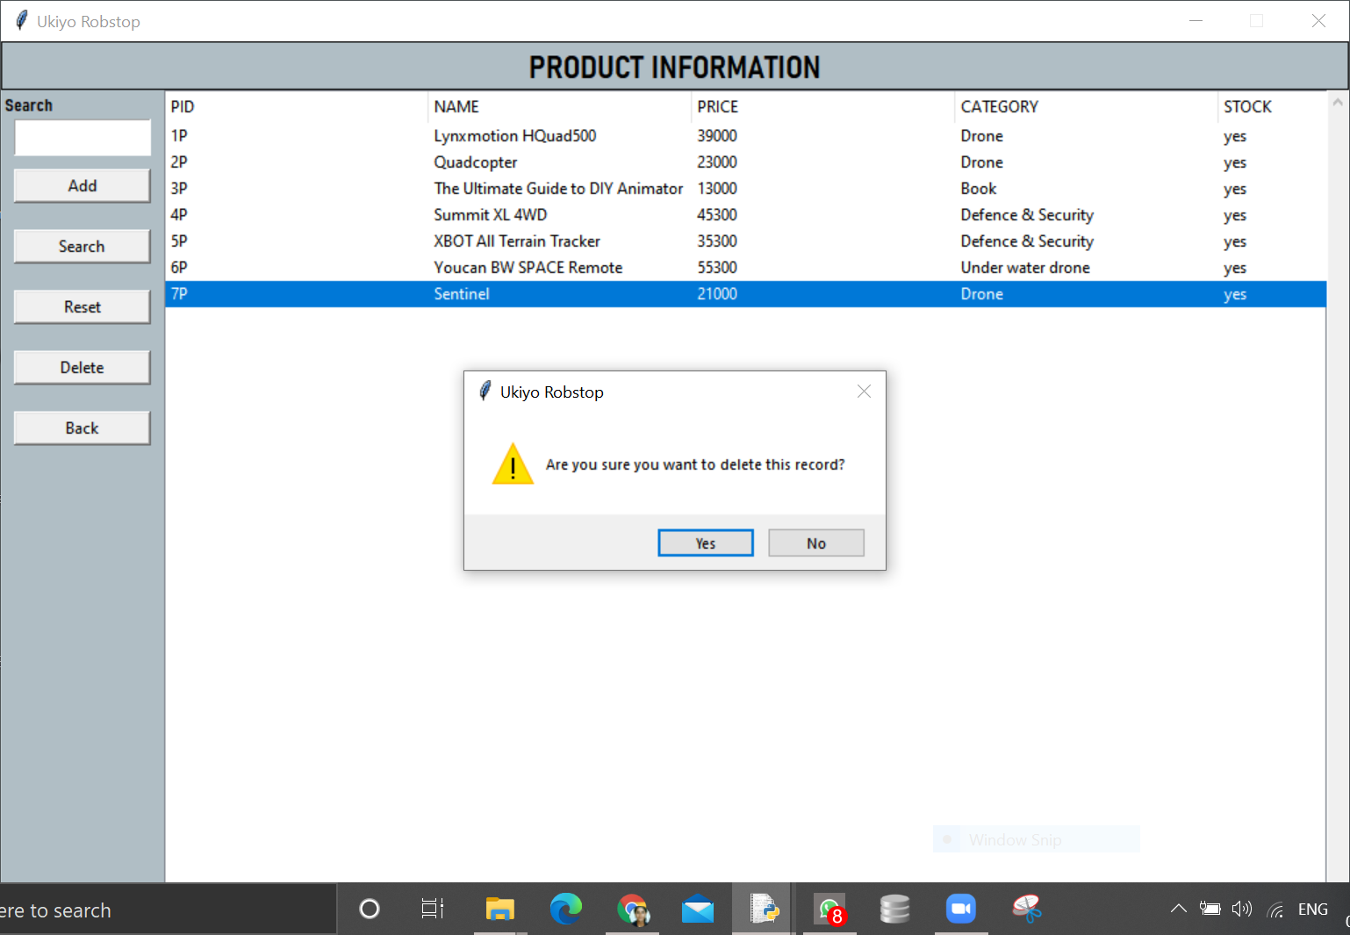
Delete A Product

Slide 12
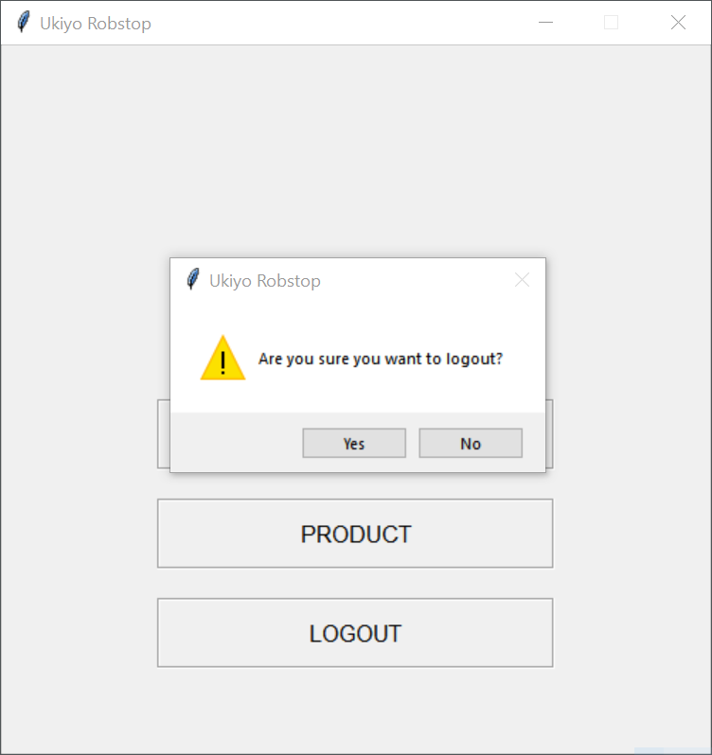
Admin Logout

Slide 13
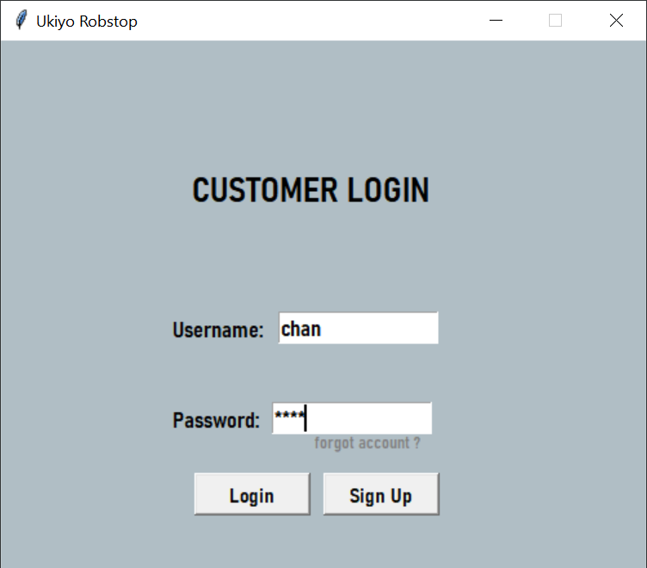
Customer Login

Slide 14
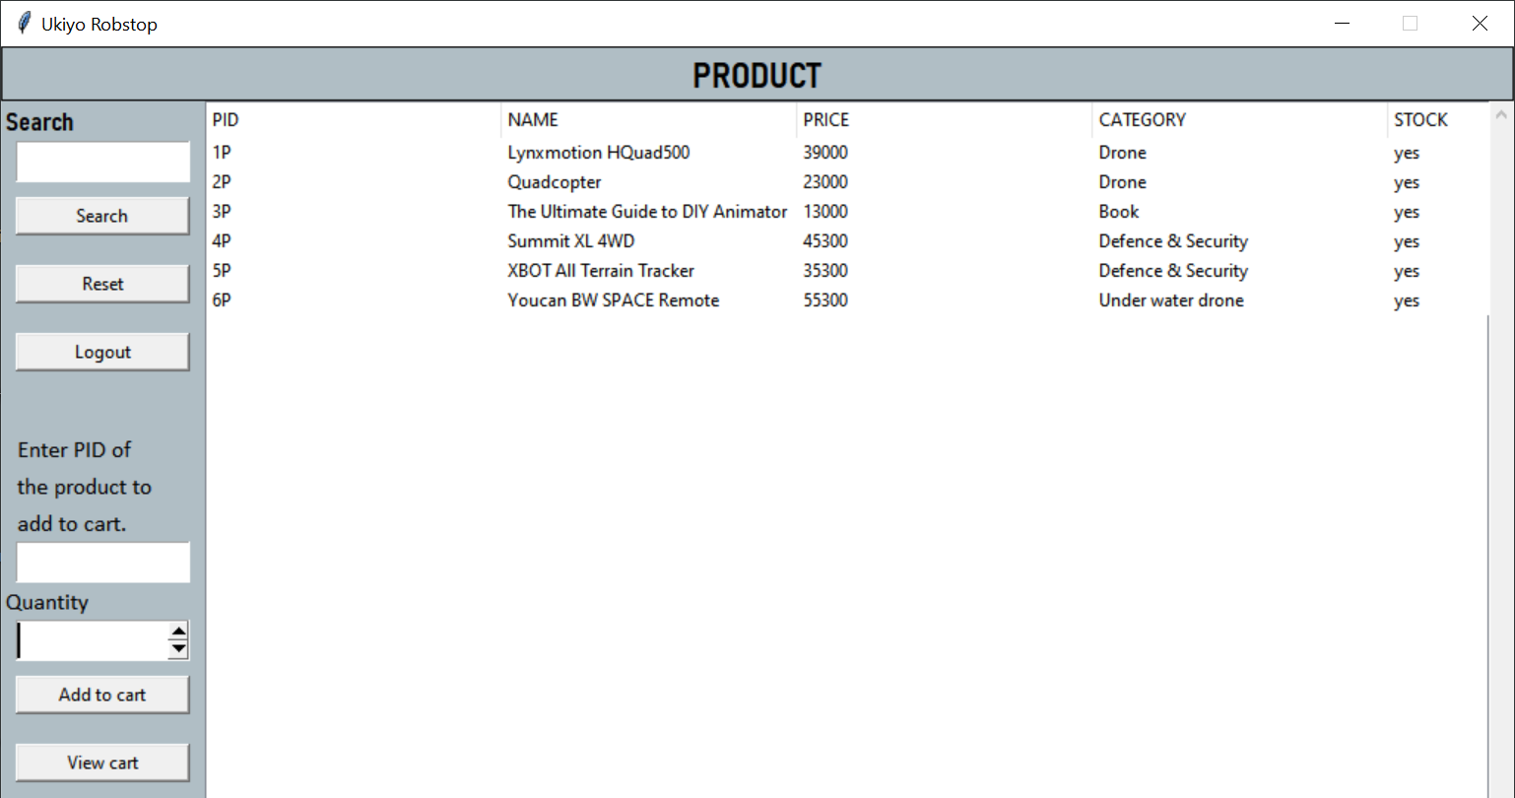
Customer Portal

Slide 15
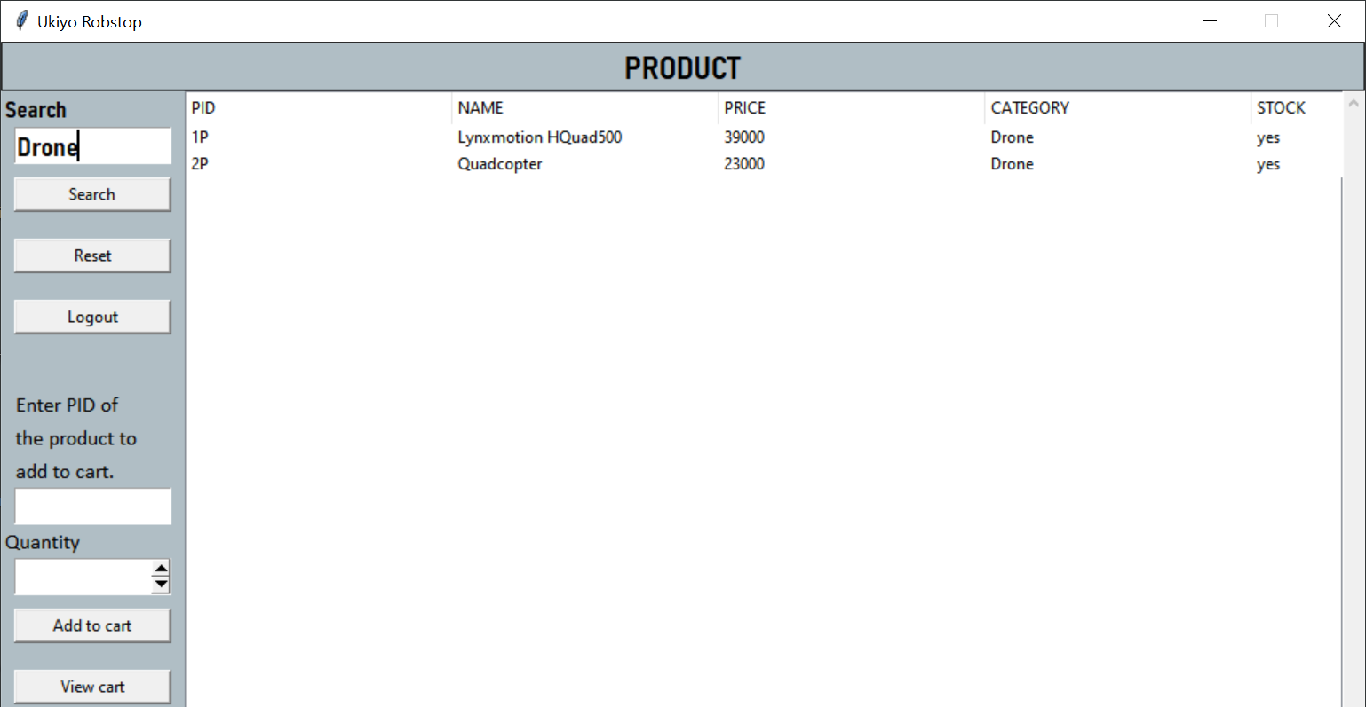
Search Product By Product Category

Slide 16
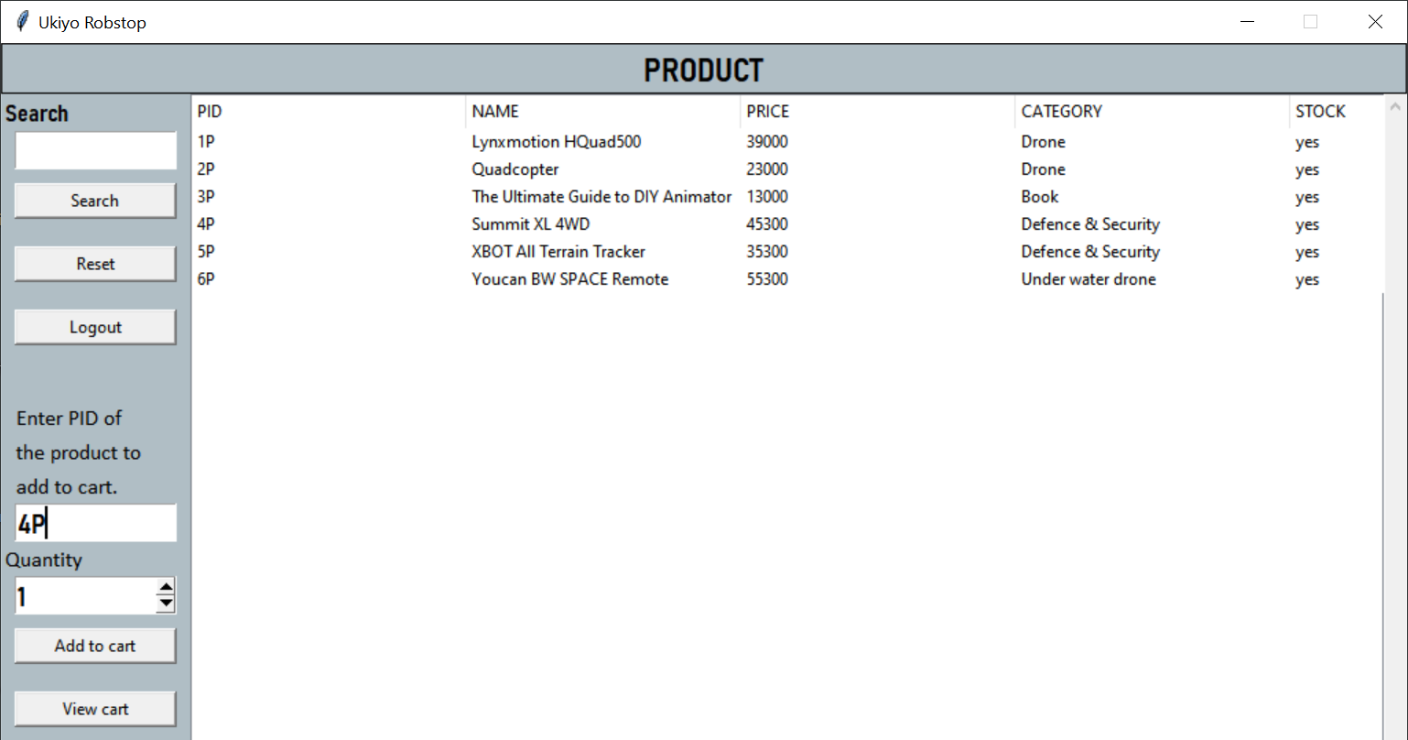
Add To Cart

Slide 17
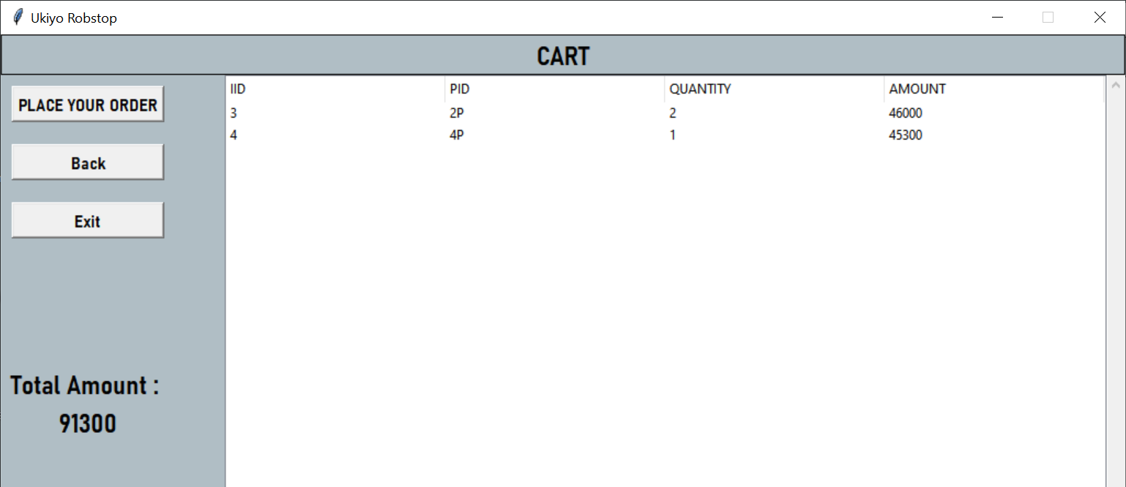
View Cart

Slide 18
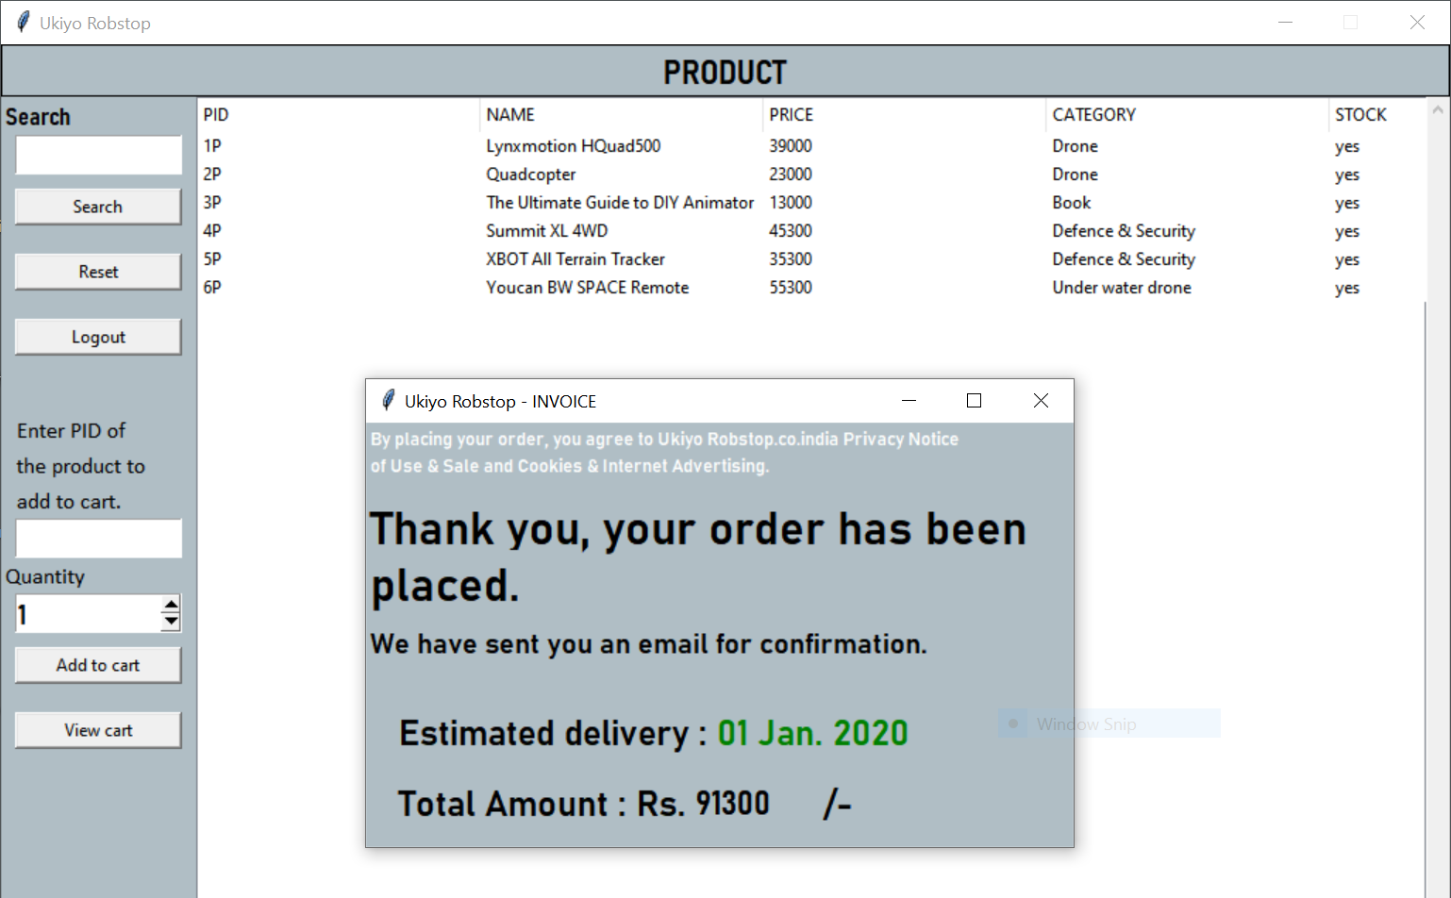
Place Order

Slide 19
Thank you

